Slide 1

Intuitionistic Logic III Subschemas and Topologies
Vlad Patryshev
2017
http://tinyurl.com/lambda17il

Slide 2
Background. Categories
Set - category of sets
𝟚 - category with two objects, 1 (or 3) arrows
𝟛 - category with three objects, 2 (or 6) arrows
ℕ - category of natural numbers (linear order)
A^{B} - category of functors from B to A, aka diagrams
Set^{𝟚} - category of 𝟚-diagrams in sets (see slide 4) - two sets, one function
Set^{𝟛} - category of 𝟛-diagrams in sets (we’ll get to it later)
Set^{ℕ} - category of ℕ-diagrams in sets (aka TLA+)

Slide 3
Database Schema: What Kind of Logic does it have?
User
name:Name
email:Email
dob:DOB
Name
What can go wrong?
Bad name
Bad email
Bad DOB
Bad, bad User
Email
DOB
It’s not Boolean!
First, let’s review what we know..

Slide 4
Ternary Logic: Two-State Sets (Set^{𝟚})
T₀
T₀
From previous years’ slides...
T₁
x₀:T₀
x₁:T₁
y₀:T₀
U₀
y₁:U₁
U₁
z₀:U₀
z₁:U₁
“before”
“after”

Slide 5
Ternary Logic: Set^{𝟚} - Subobject Classifier
“The attribute set pertinent to this subobject” (Paul Phillips, today)
From previous years’ slides...
⊥
⊥
?
⊤
⊤
“before”
“after”

Slide 6
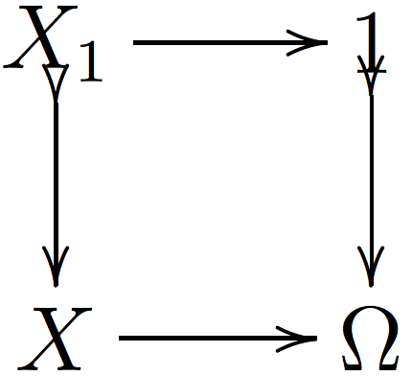
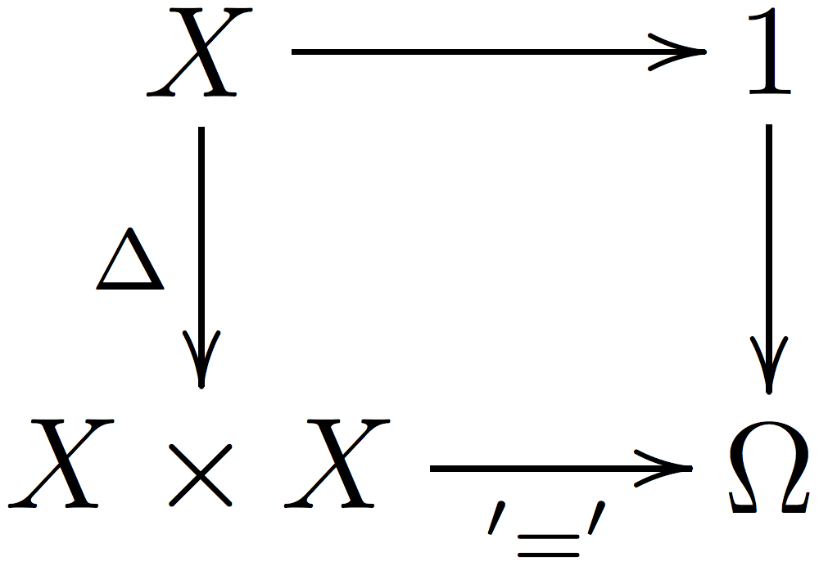
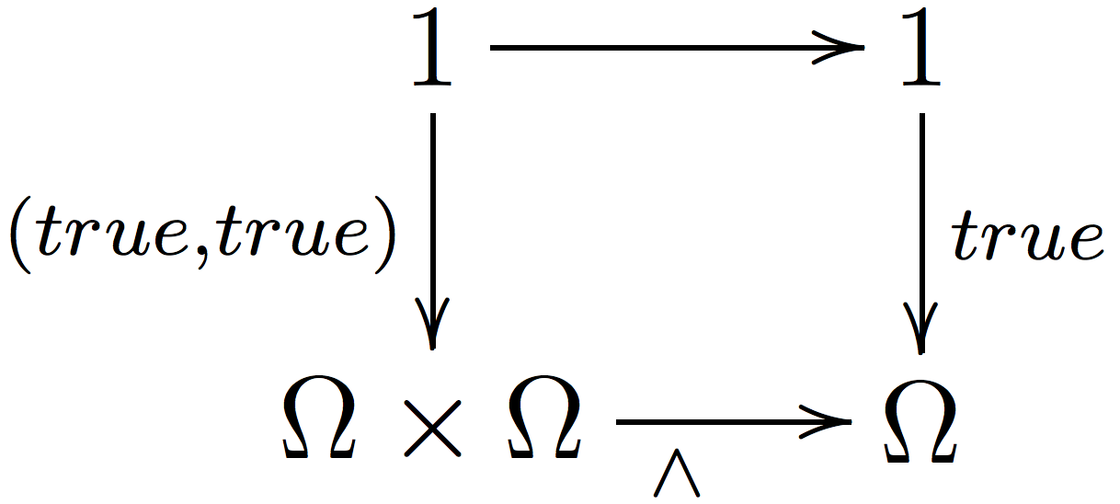
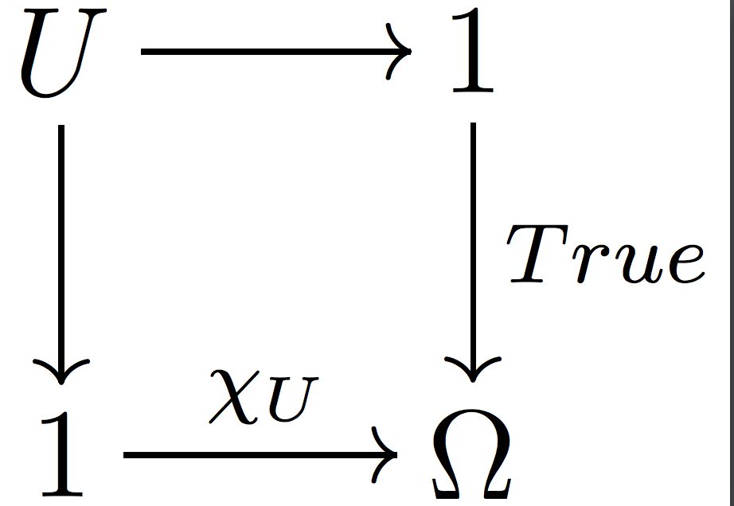
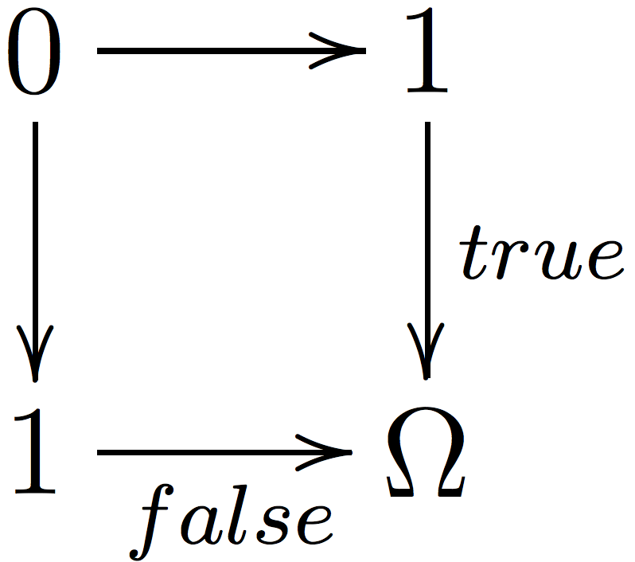
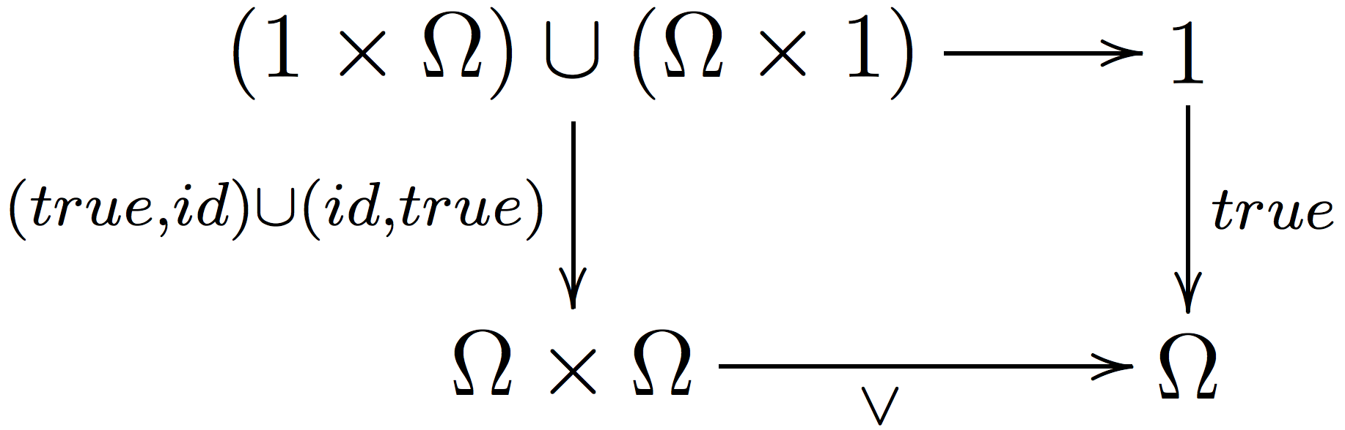
Subobject Classifier
“The attribute set pertinent to this subobject” (Paul Phillips, today)
Definition
Equality
Conjunction
Logical Values
False
Disjunction

Slide 7
Yesterday, Today, Tomorrow - Set^{𝟛}
“yesterday”
“today”
“tomorrow”

Slide 8
Yesterday, Today, Tomorrow - Its Logic
⊥
⊥
⊥
2
1
1
⊤
⊤
⊤
“yesterday”
“today”
“tomorrow”

Slide 9
Yesterday, Today, Tomorrow
Bad
Bad
Bad
Wait till after tomorrow
Wait till tomorrow
Wait till tomorrow
Good
Good
Good
“yesterday”
“today”
“tomorrow”

Slide 10
Yesterday, Today, Tomorrow
If we only care about today
Bad
Bad
Good
Good
Good
“yesterday”
“today”
“tomorrow”

Slide 11
Yesterday, Today, Tomorrow
If we only care about today
The transition to “only today counts” is a closure operation:
X ⊂ X~
X~~ =X~
(X∩Y)~ =X~∩Y~
Bad
Bad
Good
Good
Good
“yesterday”
“today”
“tomorrow”

Slide 12
Yesterday, Today, Tomorrow - The Logic
⊥
⊥
⊥
2
1
1
⊤
⊤
⊤
“yesterday”
“today”
“tomorrow”
You see a closure of Truth

Slide 13
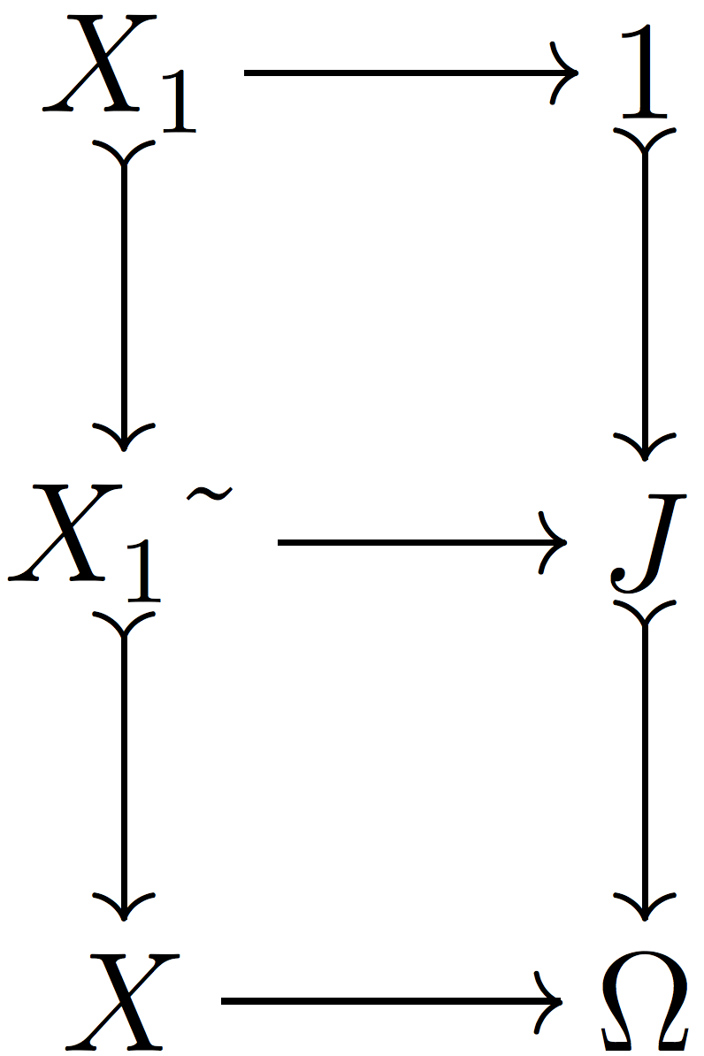
Pullback diagram for Closure
X₁~ is the closure of X₁ in X
J is the closure of Truth in Ω
Grothendieck topology is such a closure operation, or, equivalently, the closure of Truth in Ω

Slide 14
Today
Yesterday and tomorrow
Every day
Eventually (double negation)
Never
1
⊥
⊤
⊤
⊤
1
⊤
⊤
⊤
⊤
⊤
⊤
2
1
1
⊤
⊤
⊤
⊥
2
⊥
1
1
⊥
⊤
⊤
⊤

Slide 15
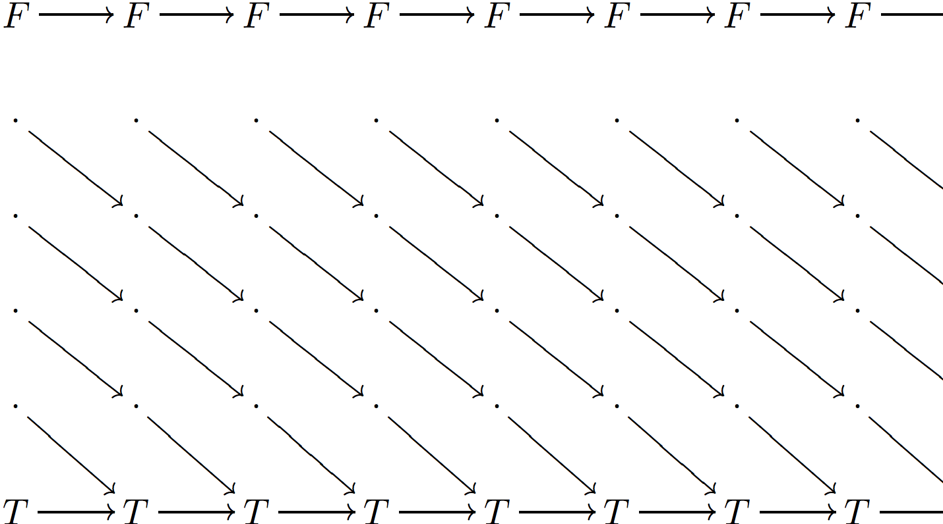
TLA+: time axis = ℕ and its classifier
X₀→X₁→X₂→X₃→...
Objects
(sets with transitions)
Classifier
Topologies:
For each subcategory of ℕ
¬¬ (◇ in Temporal Logic)

Slide 16
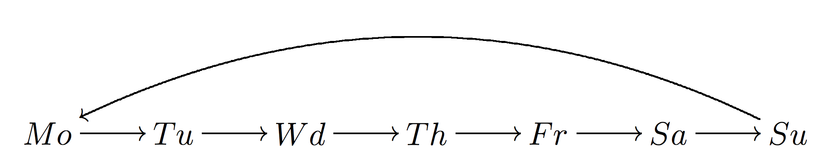
Groundhog Week
Check out a smaller monoid...
It’s a groupoid, so the logic is trivial Boolean, and there are just two topologies.

Slide 17
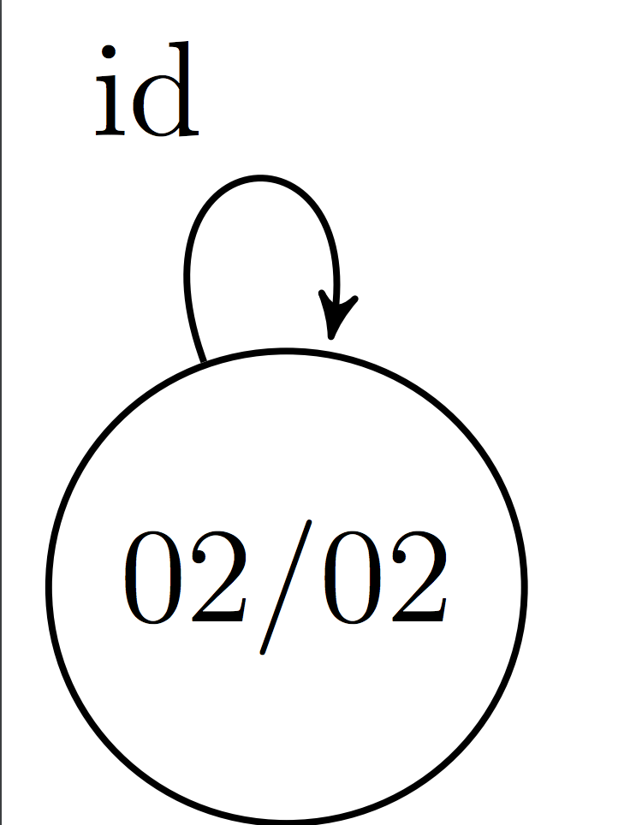
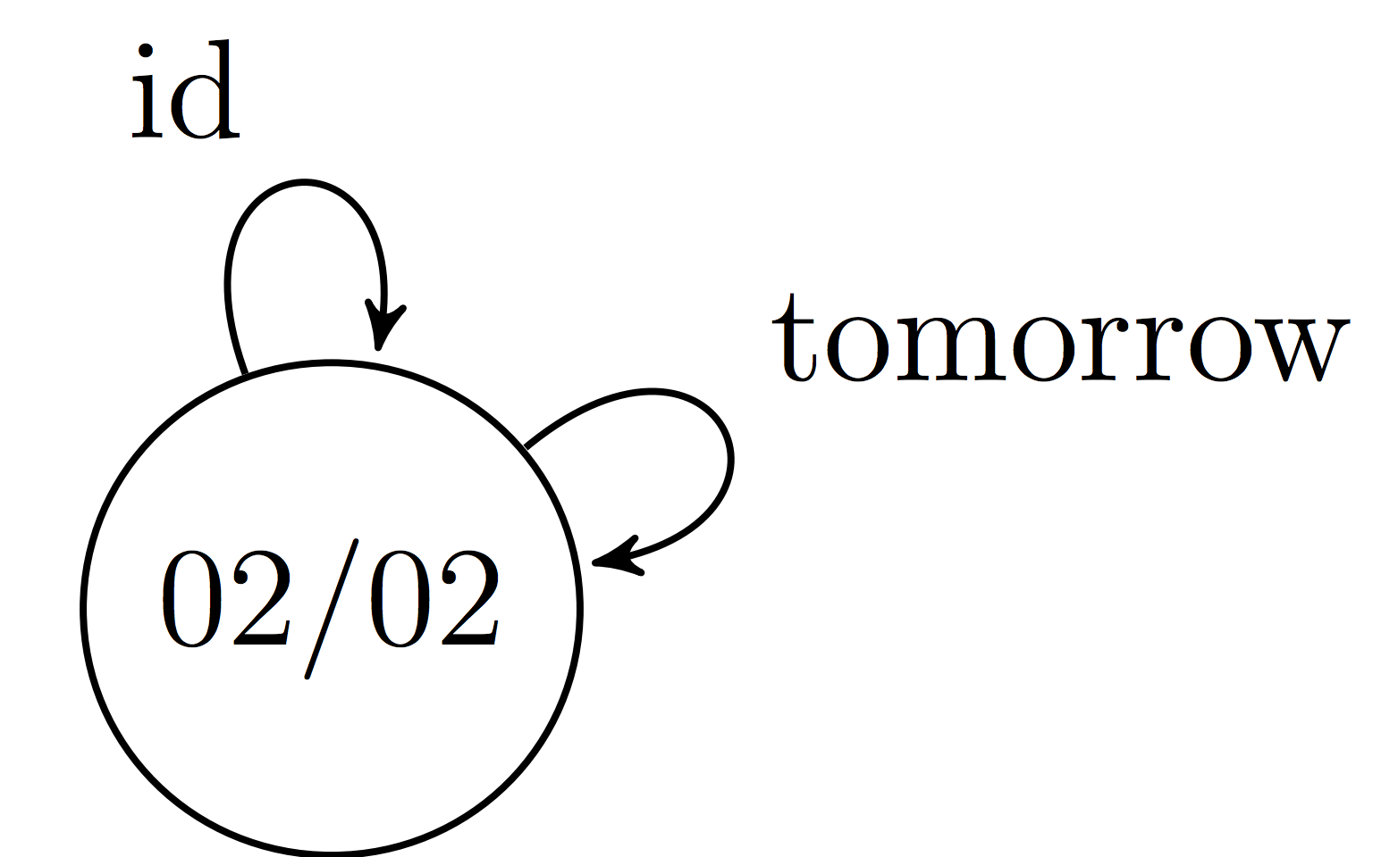
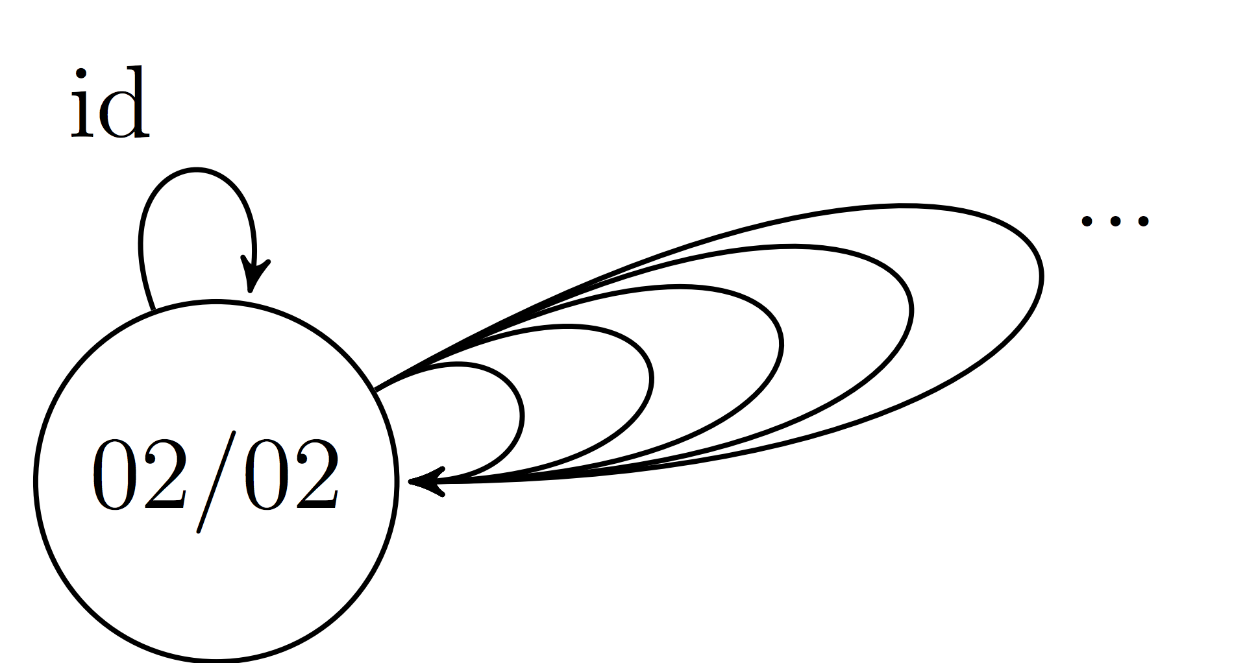
Groundhog Day
Rita’s world | Phil’s world according to him | Phil’s world according to the movie
Boolean 2-valued logic, trivial topologies | Logic: {⊤,tomorrow,⊥} Topologies: trivial ¬¬ degenerate | Logic: {⊤,1,2,...,⊥} Topologies: Trivial ¬¬ [n] for each n degenerate

Slide 18
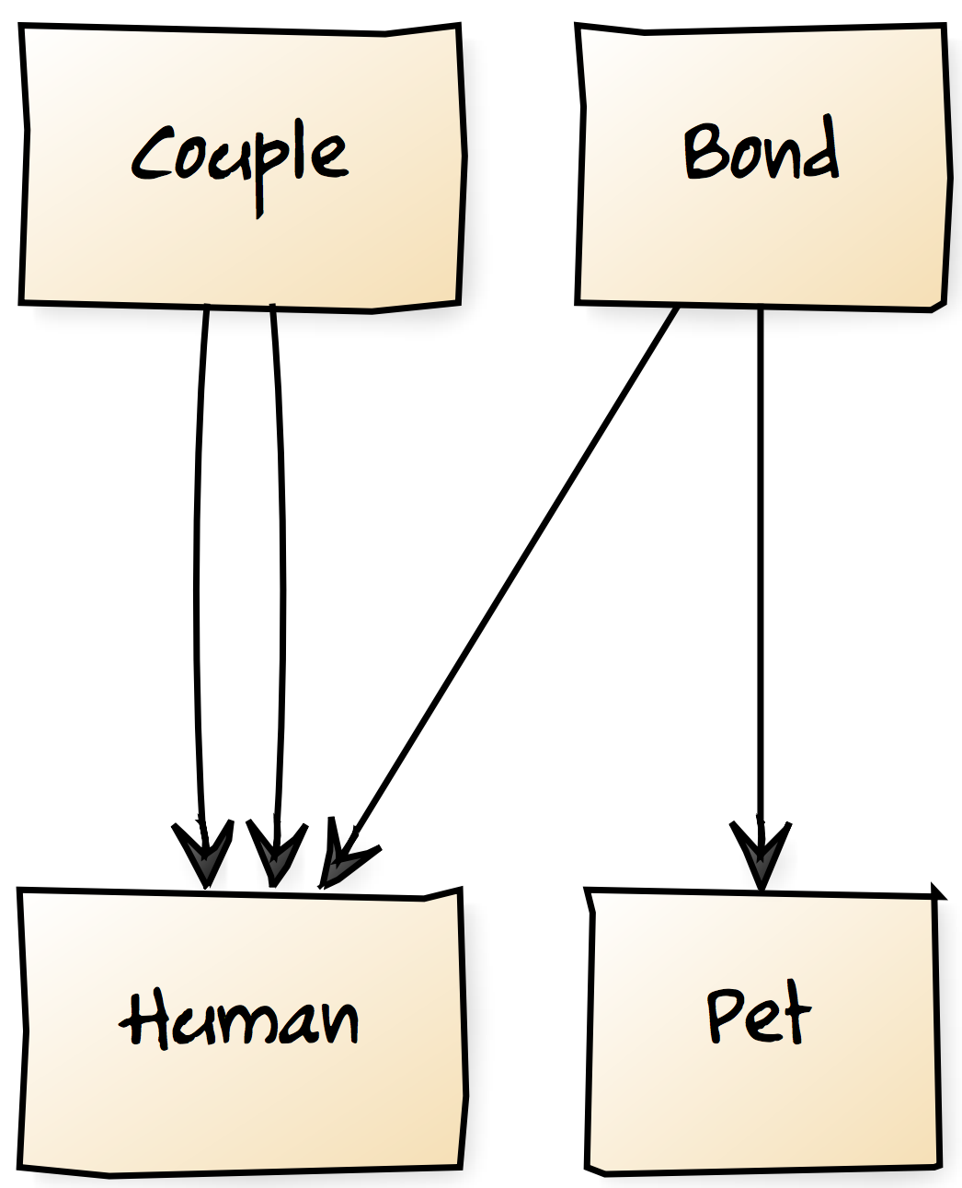
Schema From Last Year
Three objects, two (non-trivial) arrows

Slide 19
Subobject Classifier from Last Year
Good Bond (Good Human, Good Pet)
Bad Bond (Good Human, Good Pet)
(Good Human, Bad Pet)
(Bad Human, Good Pet)
(Bad Human, Bad Pet)
The diagram consists of three sets and two functions
What can go wrong?
The person can be bad
The pet can be bad
Both can be good, but the bond can be bad
Good Human
Bad Human
Good Pet
Bad Pet
Logical operations defined component-wise

Slide 20
Subobject Classifier from Last Year
⊤,(⊤,⊤)
HP,(⊤,⊤)
H,(⊤,⊥)
P,(⊥,⊤)
⊥,(⊥,⊥)
The diagram consists of three sets and two functions
What can go wrong?
The person can be bad
The pet can be bad
Both can be good, but the bond can be bad
⊤
⊥
⊤
⊥

Slide 21
Topologies are Simple
Topology | Domain
Trivial | H,P,B
Ignore bonds | H,P
Pets don’t matter | H,B
Humans don’t matter | P,B
Just humans | H
Just pets | P
Just bonds | B
Degenerate | ∅

Slide 22
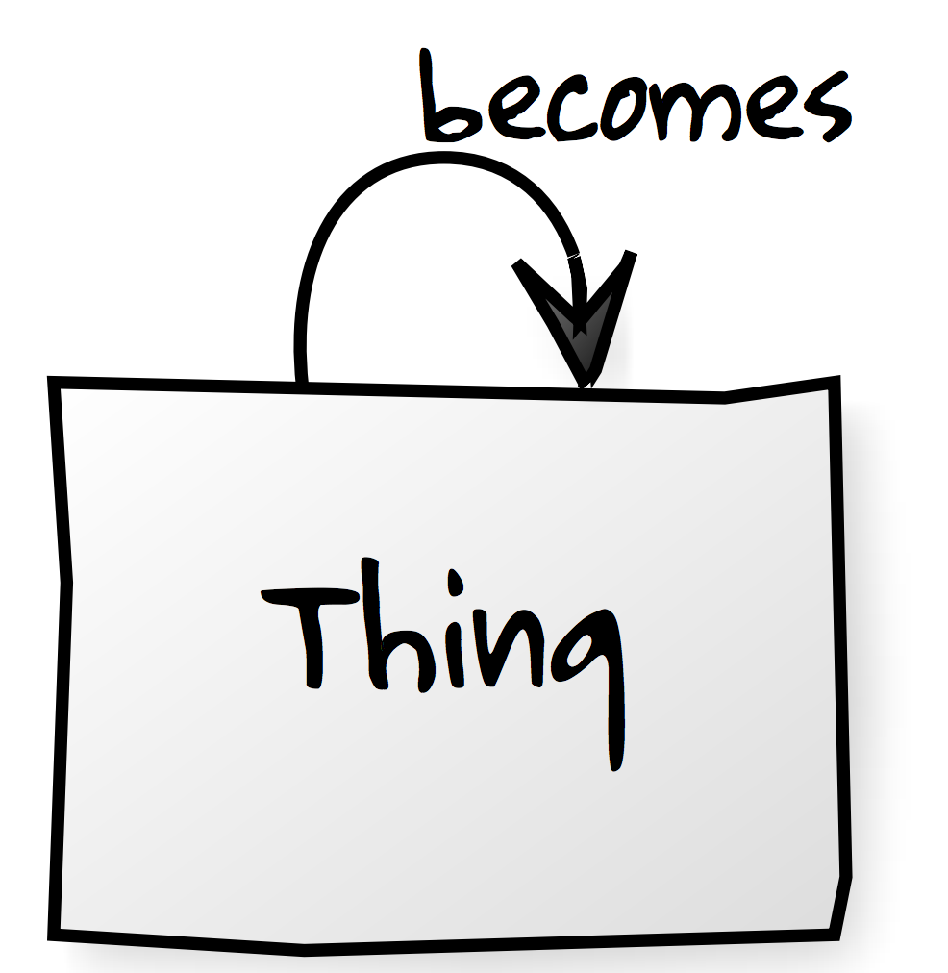
Groundhog Day Schema 1
Like this. No way to trace failures.
Apache BEAM does not allow it

Slide 23

Groundhog Day Schema 2
Logic: {⊤,1,2,...,⊥}
Topologies:
Trivial
¬¬
[n] for each n
degenerate
No way to track failures

Slide 24
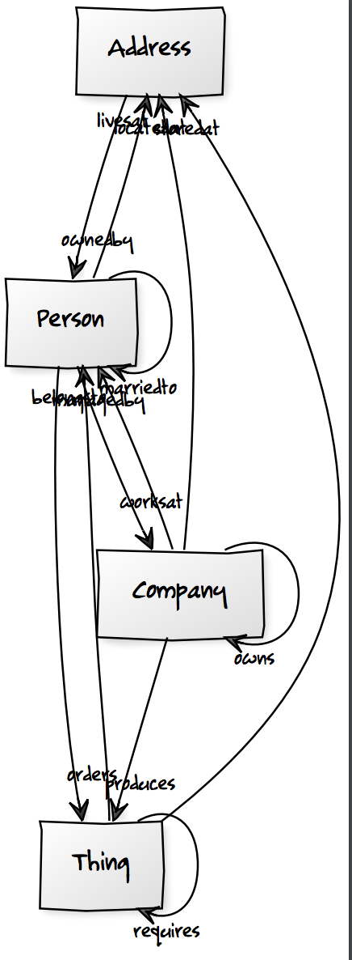
Real Life Schema
Logic is hardly penetrable
Topologies are enigmatic
Tracking errors hardly possible
It’s a fact of life
(Real life example: a family database where marking yourself as a dependent of someone that has you a dependent kills the UI)

Slide 25
Links
P.T.Johnstone, "Topos Theory"
Ceciia Fiori, "A First Course in Topos Quantum Theory"
Introduction to Intuitionistic Type Theory (LambdaConf 2015) (video)
Intuitionistic Logic of Database Schema (LambdaConf 2016) (video)

